Slide 1
AI BLOGNEST API
Presented by:
-Benishwar s (Team Lead)
-Santosh s
-deva m
-Dhanush g
-Kishore s

Slide 2
Project Presentation
-Developed using Node.js and Express.js
-MongoDB for database management
-REST API for blog operations
-AI integration for blog generation and summarization

Slide 3

-BlogNest is a backend project for managing blogs.
-It allows users to create, view, update, and manage blog content.
-It stores information in a MongoDB database.
-It supports user authentication and different user roles.
-It includes AI features for generating and summarizing blog content.

Slide 4
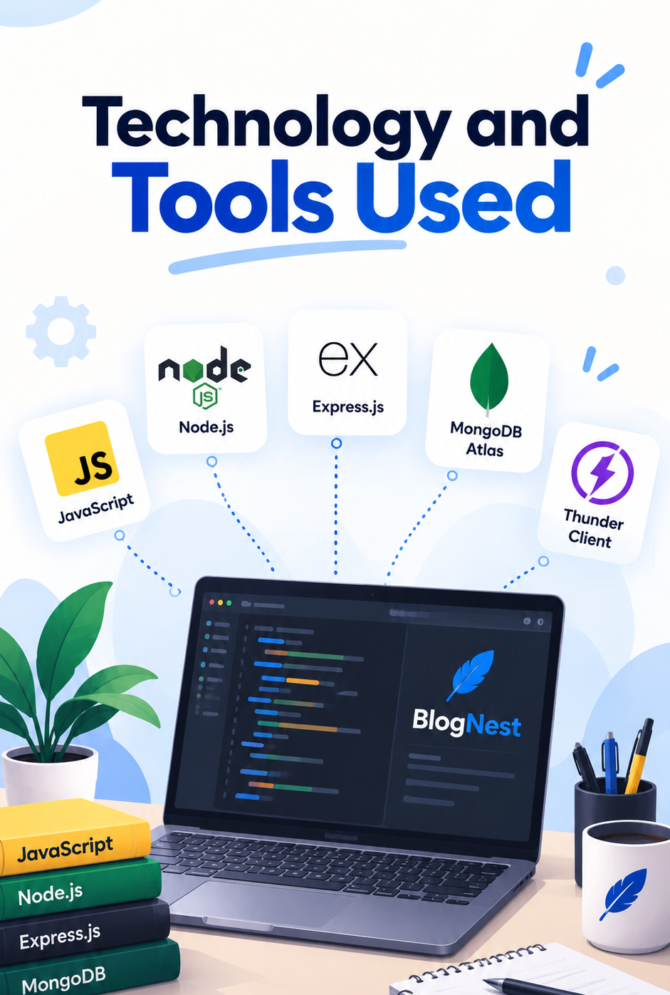
Programming Language
-JavaScript: Used to write the backend logic.
Technologies
-Node.js: Runs JavaScript on the server.
-Express.js: Handles API routes and HTTP requests.
-MongoDB: Stores users, blogs, and related information.
-Mongoose: Connects Node.js with MongoDB and manages data schemas.
-JWT: Used for user authentication.
-Google Gemini AI: Supports AI-powered content features.
Development and Testing Tools
-Visual Studio Code: Used to write and manage the code.
-Postman / Thunder Client: Used to test API requests and responses.

Slide 5
Backend Architecture
How Does BlogNest Work?
The client sends a request to the backend.
Express.js receives the request and directs it to the correct route.
Middleware checks authentication and permissions when required.
Controllers handle the application logic.
Mongoose communicates with MongoDB to store or retrieve data.
The backend returns a JSON response to the client.
Basic Flow:
Client → Express.js → Routes → Controllers → MongoDB → Response

Slide 6
HTTP Methods and CRUD Operations
What Are HTTP Methods?
POST: Creates new information, such as a blog post.
GET: Retrieves information, such as viewing blogs.
PUT: Updates existing information.
DELETE: Removes information.
What Is CRUD?
CRUD stands for:
C — Create
R — Read
U — Update
D — Delete
These are the basic operations used to manage blog data through the API.

Slide 7
Main Features of BlogNest
Blog Management
-Create, view, and update blog content.
-Organize blogs using categories and tags.
-Manage comments on blog posts.
User Management
-Register and log in users.
-Support four roles: Admin, Editor, Author, and Reader.
-Restrict access to protected operations.
AI Features
-Generate blog content using AI.
-Summarize long articles.
-Provide additional AI-assisted features documented in the project.

Slide 8
Security and API Testing
Security
JWT Authentication: Verifies authenticated users.
Password Hashing: Protects stored passwords.
Role-Based Access: Controls what different users can do.
Input Validation: Checks submitted information.
Error Handling: Helps manage errors consistently.
API Testing
Used Postman / Thunder Client to send API requests.
Checked the responses returned by the backend.
Tested operations such as registration, login, blog creation, and blog retrieval.
Tested the documented AI generation and summarization features.
Purpose: To check whether the API works correctly and responds as expected.

Slide 9
Future Enhancements
Add a simple user interface.
Add a password reset feature.
Improve blog search.
Allow readers to bookmark favourite blogs.

Slide 10
Conclusion
Successfully developed a backend API for blog content management.
Used Node.js and Express.js to handle server-side operations and API requests.
Used MongoDB and Mongoose to store and manage application data.
Implemented CRUD operations for managing blog content.
Included user authentication and role-based access control for better security.
Integrated AI features for blog generation and article summarization.
Used Postman / Thunder Client to test API endpoints and check responses.
Organized the backend into separate modules, making the code easier to maintain.
Gained practical knowledge of backend development, database connectivity, and REST APIs.
Created a foundation that can be extended with a frontend and additional features in the future.

Slide 11
Thank you

